Slide 1
SYSTEM FUNCTIONALITY
Notes:
Entered text
Linux pasword managemnet introduction, a blck page to put my presonal information, with etc/shadow, cange pasword, etc/login.defs, openssl, crypt, generating god pasword, locking an acount and unlock it, edit local files, cheat shet, and other information which you wil want to add in password managemnt in linux operating system how to observe pasword in linux importance of pasword managemet in linux

Slide 2
System functionality is what a system does. For example, the Cholera Reporting Management System is built to manage cholera patients and does cool things like:
Adding new patients
Managing patient records
Recording deaths
And more awesome features we’ll talk about later!
Think of it as the system’s "to-do list" for saving lives!

Slide 3
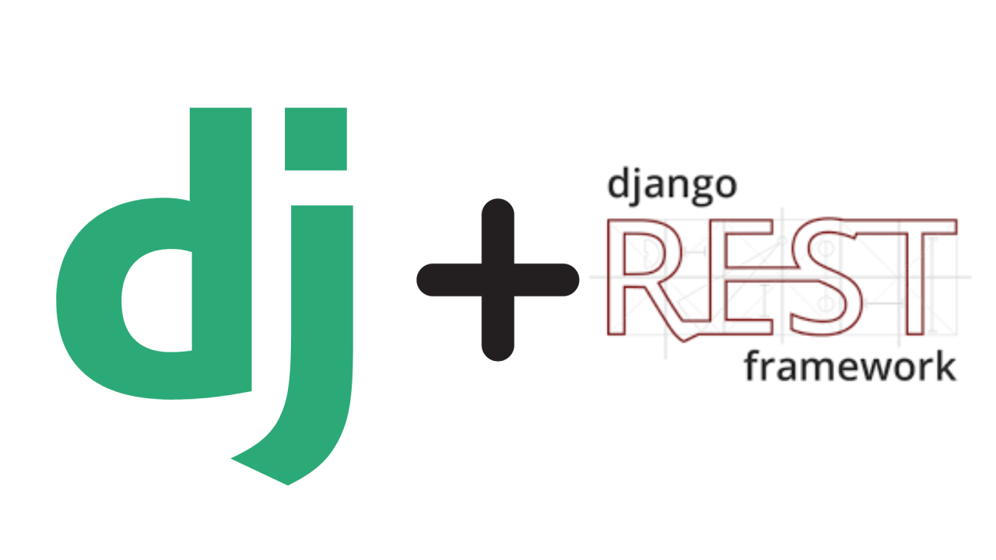
Django
REST FRAMEWORK

Slide 4
Django Rest Framework (DRF):
Is a powerful and flexible toolkit for building Web APIs with Python's Django framework. It simplifies the process of turning Django models and views into APIs that can serve data to clients like web applications, mobile apps, or other external systems.

Slide 5

Mmmmhh New Terminology!!!! API????

Slide 6
An API (Application Programming Interface): Is a set of rules and tools that allows different software applications to communicate with each other. It acts as a bridge, enabling one system to interact with another in a structured way. APIs make it possible for applications to exchange data and functionality without exposing their internal code.

Slide 7
So!!! Django can be connected and interact with different System???

Slide 8
Yes!!! you can conect with in diferent system ie FrontEnd Framework like, React Angular and others

Slide 9
How??

Slide 10
By Creating API

Slide 11
Understand the Data You’ll Deal With Before creating an API, you need to understand the structure and format of the data.
Most APIs exchange data in JSON (JavaScript Object Notation) because it is lightweight, easy to read, and widely supported.
So in order to Interact with other system WE should deal with creating our backend to suport interactig with JSON data

Slide 12
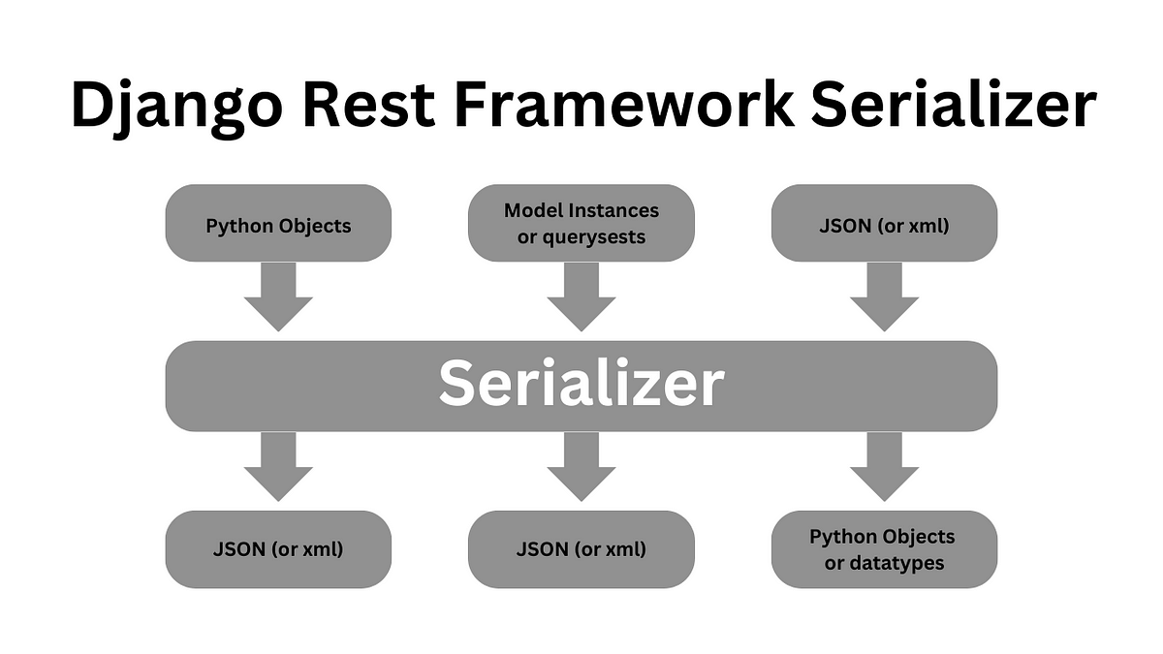

Slide 13
A serializer: In the context of web development, especially when using Django Rest Framework (DRF), is a tool that helps convert complex data types (like Django models or QuerySets) into a format that can be easily rendered into JSON, XML, or other content types. Additionally, serializers handle the reverse process, converting incoming data (e.g., JSON from a client) back into Python objects or Django models for processing and storage.

Slide 14
from rest_framework import serializers from .models import * class modelSerializer(serializers.ModelSerializer): class Meta: model = model_name fields = "__all__"

Slide 15
first line we have import serializer from rest framework that wil help us to serialize our data to suport our API’s
we have declare our class and name our serializer class and we pass arguement within balcket, worry out those word are from serializer to support our API data conversion and procesing they are always availabe in every serializer class
model:
this means you should add model you want it is data to be serialized
__all__:
This means all fields availble on that model will be serialized

Slide 16
Let’s create our System Funtionalities

Slide 17
Every system should perform (CRUD) function that means Create, Read, Update and Delete all of them can be done also by using Django Rest Framework So That this is how django will interact with other System

Slide 18
Read
This is used to display data from backend that user can see them to the front-end and this devided in to many form some of them are
Get all
Get By Id
get by specific feature
How does GET work
First It establish the request to the server ask for certain data then the server provide response by using GET method to comunicate to server

Slide 19
GET ALL
This is just like SELECT * in sql queries
In django we use Built in djnago function
all()

Slide 20
How does it work
First It establish the request to the server ask for certain data then the server provide response by using GET method to comunicate to server

Slide 21
from rest_framework.decorators import api_view
from rest_framework.response import Response
from .serializers import *
@api_view([‘GET’])
def getpatient(request):
if request.method == 'GET':
instances = model_class.objects.all()
serializer = serializer_class(instance, many=True)
return Response(serializer.data)

Slide 22
GET BY ID
#Get by Id only focus on get only one element based on it is id
from rest_framework.decorators import api_view
from rest_framework.response import Response
from .serializers import *
@api_view([‘GET’])
def getpatient(request, id):
if request.method == 'GET':
instances = model_class.objects.get(id=id)
serializer = serializer_class(instance)
return Response(serializer.data)

Slide 23
Filter
This focus on selecting items according to the specific category
@api_view([‘GET’])
def getPatientWithHighFever(request):
if request.method == 'GET':
instances = model_class.objects.filter(patient_status=’High’)
serializer = serializer_class(instance, many=True)
return Response(serializer.data)

Slide 24
To be continue.....

